Slide 1
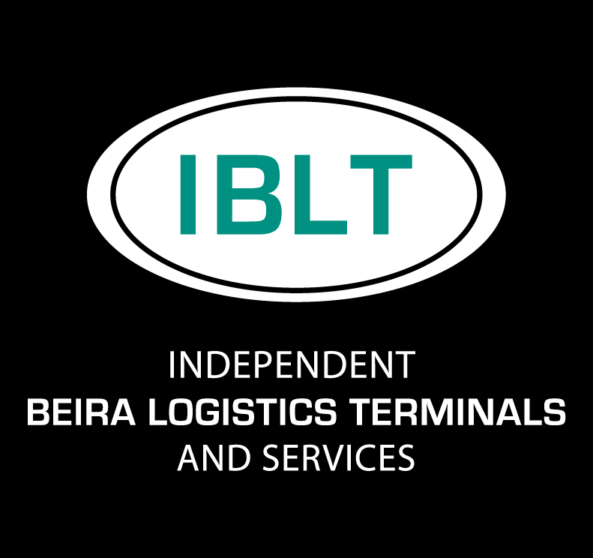
COMPANY OVERVIEW

Slide 2
Who is IBLT&S?
IBLT&S is a state-of-the-art warehouse, depot and logistics facility in Beira, Mozambique, servicing import and export customers in Mozambique, Zimbabwe, Zambia, Malawi and the Eastern DRC.
We specialise in handling and storage of break bulk and bulk products such as minerals, tobacco, peas, rice, fertilizers and wide range of other commodities.
Established in August 2013, IBLT&S
Warehouse servicers provider since 2016
Member of the J&J Group
Local cargo and bonded area for transit cargo
High-security operation
130,000m² total area (20,000m² under roof)

Slide 3
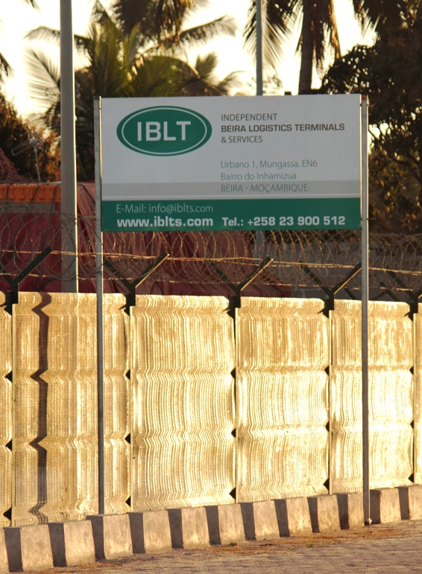
Why use Beira?
Over the past years Beira port has become the most agile gateway to serve the Central Mozambique, Malawi, Zambia, Eastern DRC and Zimbabwe markets.
Beira logistics corridor has persisted in becoming the alternative for cost effective, fast and reliable transportation.
After dredging the channel and huge infrastructural investments Beira must be considered as an alternative to Durban and Dar Es Salaam for shippers who need a fast, cost effective and no headache logistics solution in this part of the world to avoid congestion, escalating costs and unpredictability of nearby alternatives.

Slide 4
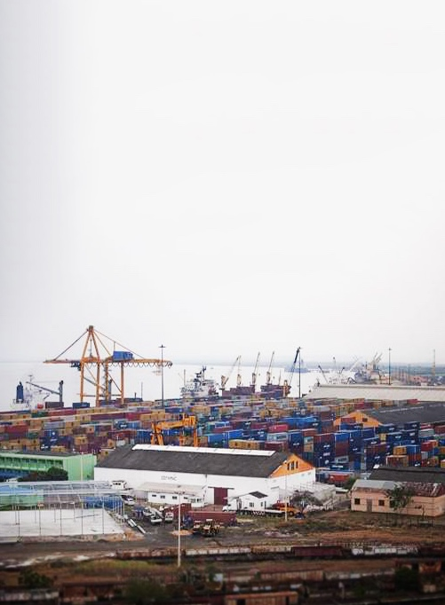
Why use Beira?
J&J Group saw the opportunity in Beira and continues to invest in the following areas…
We have:
Invested in our state of the art warehouses
Invested in a state of the art inland container depot
Invested in IT systems to guarantee you have full visibility of the flow of goods and the flow of information
Invested in a state of the art, well maintained fleet with workshops in 3 countries
Invested in people, our biggest asset, growing our number of hires by 15% in the last year.

Slide 5
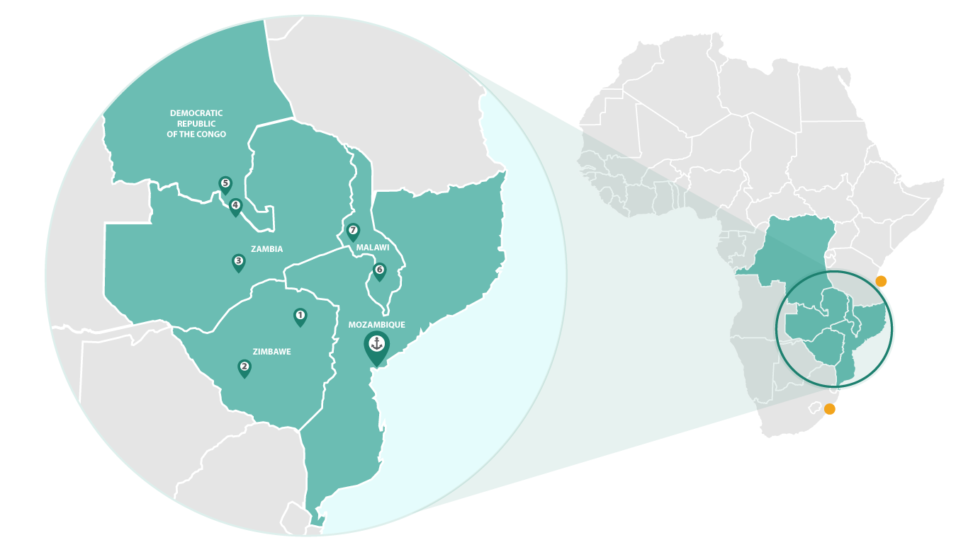
Location
Distance in Kilometers:
Harare, Zimbabwe - Beira: 559
Durban: 1,711 | Dar es Salaam: 2,634
Bulawayo, Zimbabwe - Beira: 726
Durban: 1,454 | Dar es Salaam: 3,028
Lusaka, Zambia - Beira: 1,054
Durban: 2,380 | Dar es Salaam: 1,985
Kitwe, Zambia - Beira: 1,370
Durban: 2,707 | Dar es Salaam: 1,951
Lubumbashi, DRC - Beira: 1,600
Durban: 2,611 | Dar es Salaam: 2,290
Blantyre, Malawi - Beira: 812
Durban: 2,323 | Dar es Salaam: 2,031
Lilongwe, Malawi - Beira: 950
Durban: 2,678 | Dar es Salaam: 1,667
1
2
3
4
Dar es Salaam
5
Durban
6
7

Slide 6
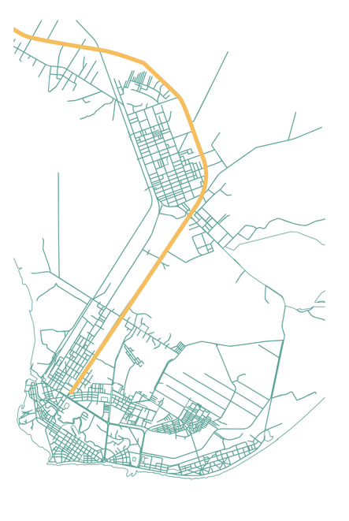
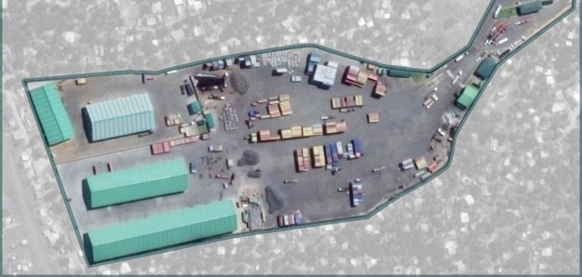
IBLT Setup and Facilities
1
Total Capacity:
10,000m²
6,000m²
4
5
Of bonded warehouse space (+4,000m² planned for 2018)
Local warehouse space
IBLT&S
1
5
Port
2
3
EN6 Highway
3
4
2
55,000m² Of paved logistics area
22mt / 70mt Weighbridge + Axle & Container Scale
24h Security control

Slide 7
Services - Container Depot
SERVICES
All our premises are access controlled and under 24/7 CCTV surveillance to ensure maximum security of your cargo. We also utilize a high quality Terminal Operating System from a 3rd party provider, which enables us to update our customers with timely and accurate data.
STRIPPING & STUFFING
Our open logistics area comprises of approximately 13 hectares of which 11 are fully paved. We operate one 45mt Full Container Handler, one Empty Container Handler (Kalmar) and several smaller machines enabling us to handle empty and full containers, 1mt IBCs, bags, pallets, drums, bulk cargo, etc.
CONTAINER STORAGE
We offer our client cost effective container storage solutions (full/empty).
FUMIGATION
Our paved logistics area is ideal for fumigation of certain containerized goods. The fumigation itself will be handled by 3rd parties which are operating on site.

Slide 8
Services - Container Depot
DANGEROUS GOODS
We are able to handle certain 'Dangerous Goods' upon request. For us to evaluate the feasibility to handle your cargo, please provide us with all details as per the International Maritime Dangerous Goods (IMDG) Code such as the IMO class, UN Number and Packing Group.
WEIGHING
IBLT&S has a 70mt / 22m heavy duty weighbridge installed on site. The heavy duty weighbridge is fully integrated into our warehouse management system and VGM (Verified Gross Mass) certified by the authorities.
We also operate a single axle and a container scale.
OUT OF GAUGE (OOG) GOODS
IBLT&S is also capable of handling OOG goods. Please inform us in detail about the dimensions (length x width x height), cargo weight (in metric tons) and the services required.
ELECTRONIC DATA INTERCHANGE (EDI)
Our computer system can be customized for EDI solutions. Please contact us for your requirements.

Slide 9
Services - Warehousing
We have a total of 16,000m² of local warehouse space and 4,000m² under construction to be completed by mid 2018.
By combining the container depot with warehouses we offer full flexibility for the handling of any cargo.
We can handle all your storage and distribution needs quickly, safely and cost-effectively.
Our facilities are backed up by well trained skilled staff with many years of experience.
We have invested in state of the art cargo tallying systems which can be designed or modified to suit client’s particular needs and requirements.
We are positioned to service all needs, providing customers with quick and cost-efficient movement of cargo to storage.

Slide 10
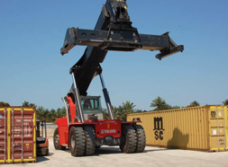
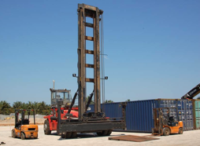
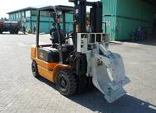
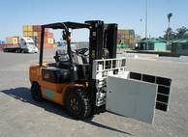
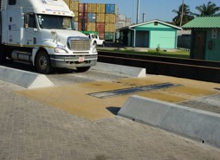
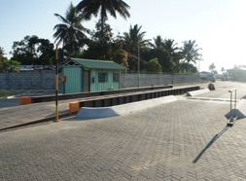
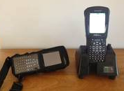
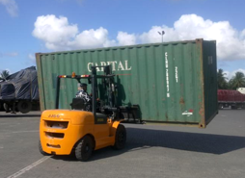
Services - Equipment List
2 X KALMAR: DRF450-60S5
1 X KALMAR EMPTY HANDLER
8 X FORKLIFT JJCC 2.5 TON WITH VARIOUS HANDLING ACCESSORIES
6 X FORKLIFT JJCC 3.0 TON
1 X AXLE SCALE FOR LOAD DISTRIBUTION CHECKS
1 X 22M WEIGHBRIDGE
PSION HANDHELD DEVICES
2 X FORKLIFT JJCC 5.0 TON

Slide 11
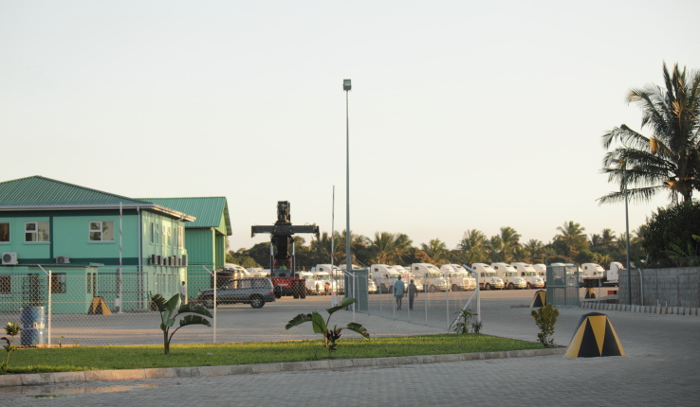
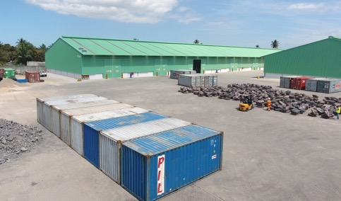
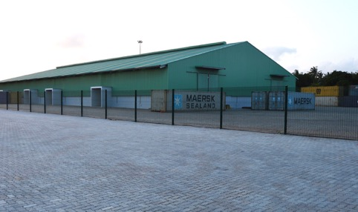
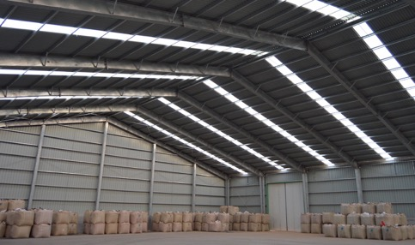
IBLT in Brief

Slide 12
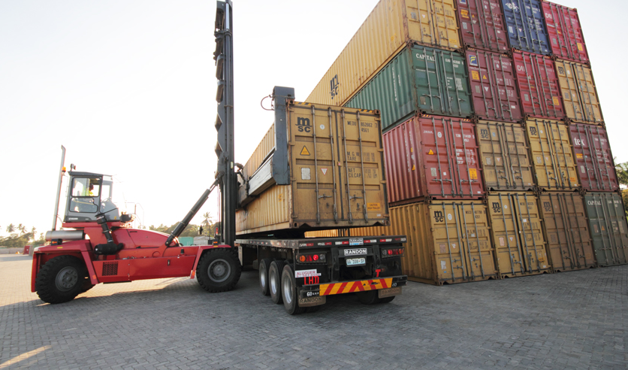
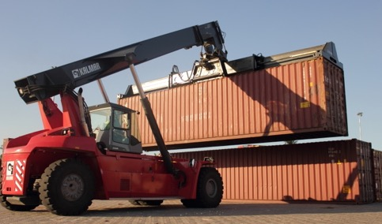
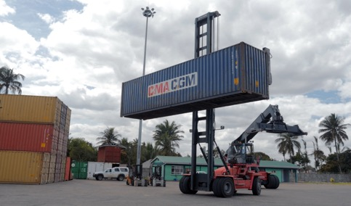
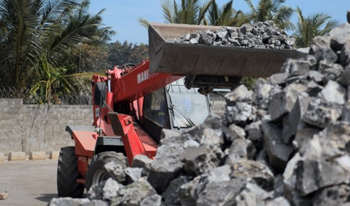
IBLT in Brief

Slide 13
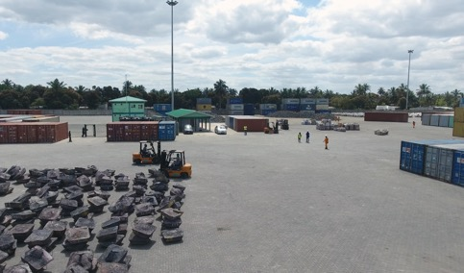
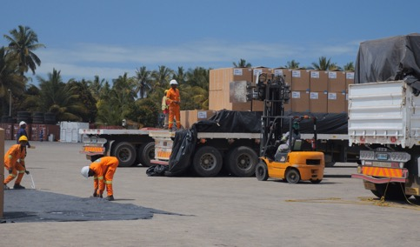
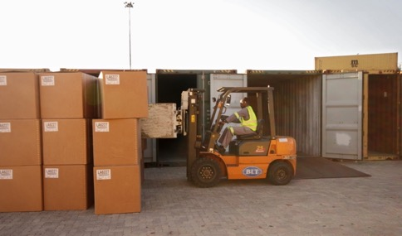
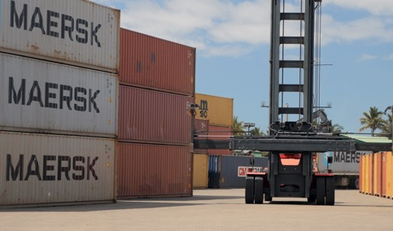
IBLT in Brief

Slide 14
Thank You
Contact Us
Independent Beira Logistics Terminals & Services, Urbana 1, Mungassa EN6, Bairro do Inhamizua Beira, Mozambique
Tel: +258 23 900 512
Mobile: +258 84 321 9782
www.iblts.com
alex@iblts.com
Office: Mon - Fri 07:30 – 17:30 | Sat - Sun 7:30 – 12:30
Terminal: Mon - Sun 07:00 – 17:30

